Slide 1
SALARY RANGES FOR DATA SCIENTISTS
Daisy Rivera
April 20, 2025

Slide 2
Average Salaries for Data Scientists
Global Average Salary: 108,187.83 Global Minimum Salary: 2,859.00 Global Maximum Salary: 412,000.00
Global
U.S.
Global Average Salary: $108,188
Global Minimum Salary: $2,859
Global Maximum Salary: $412,000
U.S. Average Salary: $149,408
U.S. Minimum Salary: $58,000
U.S. Maximum Salary: $412,000
U.S. Data Scientists on average earn 38% more than Global Data Scientist

Slide 3
Average Salaries Based Experience Levels
Entry-level
Mid-level
Senior-level
Average Salary $55,331
Minimum Salary $4,000
Maximum Salary $105,000
Median Salary $50,484
Average Salary $82,039
Minimum Salary $2,859
Maximum Salary $200,000
Median Salary $77,479
Average Salary $152,971
Minimum Salary $20,171
Maximum Salary $412,000
Median Salary $140,400

Slide 4
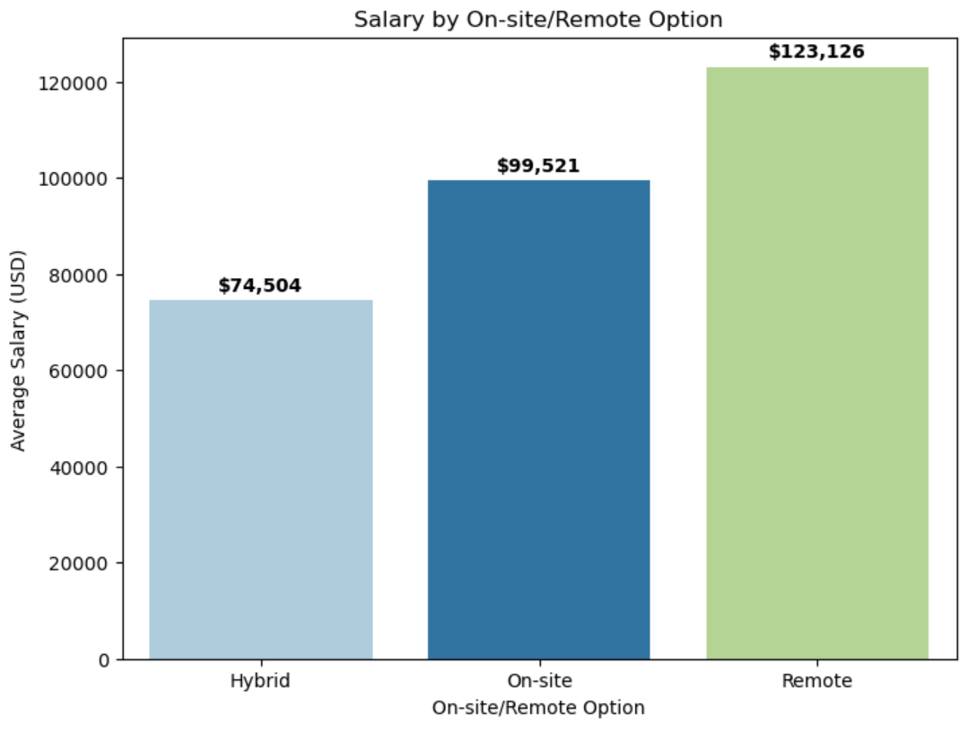
Average Salaries based on remote flexibility
Remote roles demand the highest salaries $123K
Hybrid roles average just $74K

Slide 5
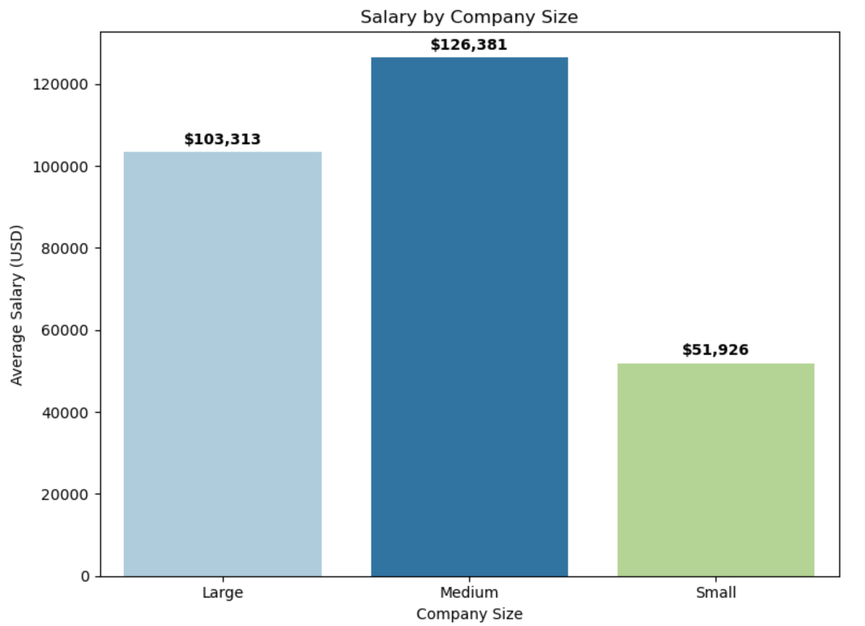
Average Salaries based on Company Size
Small companies pay an average of $52K
Medium-size companies pay more than double what small companies do, an average of $126k

Slide 6
Recommendation:
Hire a mid-level Data Scientist in a hybrid role
Hire remote senior-level Data Scientist
Compensate based on a medium-sized company
We can take advantage of lower average hybrid salaries while still allowing access to experienced professionals who can grow into a leadership role as the company scales
Though remote employees earn more on average, this gives us access to a global talent pool. Since we are growing, remote flexibility may attract stronger candidates with more expertise.
While small companies pay significantly less, our rapid growth suggests we're transitioning into a medium-sized organization. Offering competitive pay can attract talent that will help grow the company.

Slide 7

Thank you
If you have additional questions, please reach out:
Daisy Rivera
riverada@merrimack.edu

